Slide 1

Note: The data and information in this document is reflective of a hypothetical situation and client. This document is to be used for KPMG Virtual Internship purposes only.
Sprocket Central Pty Ltd
Data analytics approach
[Division Name] - [Engagement Manager], [Senior Consultant], [Junior Consultant]

Slide 2
Note: The data and information in this document is reflective of a hypothetical situation and client. This document is to be used for KPMG Virtual Internship purposes only.
Agenda
Introduction
Data Exploration
Model Development
Interpretation

Slide 3
Note: The data and information in this document is reflective of a hypothetical situation and client. This document is to be used for KPMG Virtual Internship purposes only.
Introduction
customers analysis
Age distributions
Number of bike purchases in 3 years / percentages purchases
Job industry category.
Wealth segments
Number of cars own on each states

Slide 4
Note: The data and information in this document is reflective of a hypothetical situation and client. This document is to be used for KPMG Virtual Internship purposes only.
Data Exploration
Data Exploration means understand the characteristics of given fields in underlying data such as variable distribution, whether data is skewed towards certain demographic and data validity.
There are some limitations in given datasets like some values are missing and some datasets are different according to their value.
Furthermore, transformation is required for dataset so that it is in an appropriate format for analysis. This may include steps such as ensuring that the data types are appropriate and rolling data upto an aggregated level

Slide 5
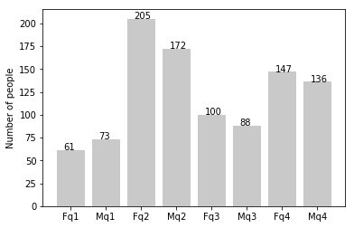
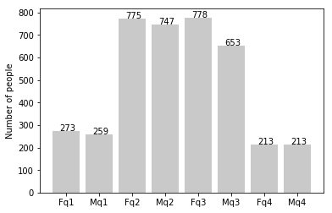
Note: The data and information in this document is reflective of a hypothetical situation and client. This document is to be used for KPMG Virtual Internship purposes only.
Data Exploration
new
Customers’ age distribution
As we can see, mostly our new customers are between 25 to 48 years old.
Number of customers from 48 to 59 years old has big drops on percentages.
There is a slightly increase in number of customers over 59 years old in term of percentages
It looks like the percentages of under 25 years old not really change.
old

Slide 6
Note: The data and information in this document is reflective of a hypothetical situation and client. This document is to be used for KPMG Virtual Internship purposes only.
Model Development
Model Development involves setting up ways of collecting data, understanding and paying attention to what is important in data and finding statistical, mathematical or simulation model to gain understanding and make prediction
In our dataset we Develop a model to see the purchases of bike in last 3 years and check in which category people have purchased more bikes. After developing based on results if the female category has more percentage of people then advertisement should be more focused towards female customers

Slide 7
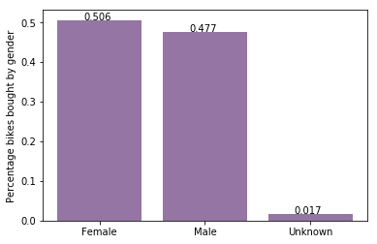
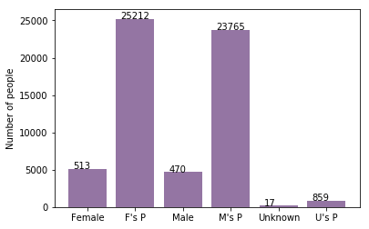
Note: The data and information in this document is reflective of a hypothetical situation and client. This document is to be used for KPMG Virtual Internship purposes only.
Model Development
Bike purchases last 3 years
As we can see, our new customers mostly Female with 50.6% purchases with total of 25,212 bikes
Male contributed to 47.7% purchases with 23,765 bikes
So we should focus on advertises on Female customers than Male customers

Slide 8
Note: The data and information in this document is reflective of a hypothetical situation and client. This document is to be used for KPMG Virtual Internship purposes only.
Interpretation
Data interpretation refers to implementation of processes through which data is reviewed for the purpose of arriving at an informed conclusion.
The interpretation of data assigns a meaning to the information analyzed and determining the conclusions, significance and implementation of the findings

Slide 9
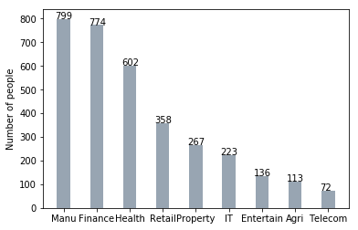
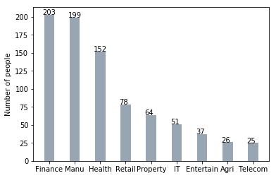
Note: The data and information in this document is reflective of a hypothetical situation and client. This document is to be used for KPMG Virtual Internship purposes only.
Interpretation
Job industry category
Mostly our new customers are on Finance industry and our Manufacturing customers are still on top 2.
The rest industries is still same

Slide 10
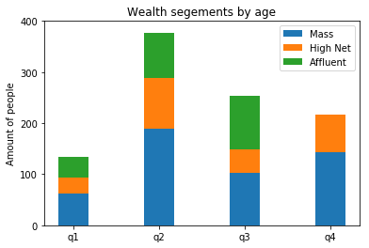
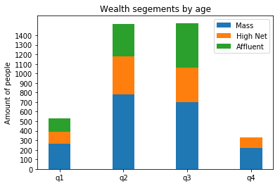
Note: The data and information in this document is reflective of a hypothetical situation and client. This document is to be used for KPMG Virtual Internship purposes only.
Interpretation
Wealth segments
In all ages, the number of Mass Customers is the highest so we should focus on this social class.
After that, we should focus on High Net Customer.
Then Affluent Customers but mostly second and third quadrant

Slide 11
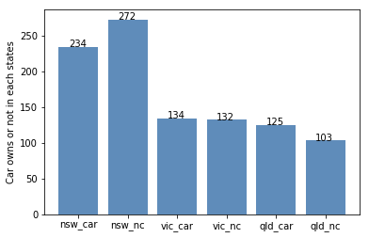
Note: The data and information in this document is reflective of a hypothetical situation and client. This document is to be used for KPMG Virtual Internship purposes only.
Interpretation
Numbers of cars owned
NSW should be considered the most since numbers of customers don’t own cars is significantly larger than that own.
VIC and QLD has more customers that own car that who don’t but we can try to have something so that those owns car will buy bikes.

Slide 12
Note: The data and information in this document is reflective of a hypothetical situation and client. This document is to be used for KPMG Virtual Internship purposes only.
Thank you

